Slide 1
Microsurgical Resection of a Thoracolumbar Dumbbell-Type Schwannoma With Preservation of the Functional Nerve Root
[Microsurgical Resection of a Lumbar (L1–2) Dumbbell-Shaped Schwannoma With Preservation of the Nerve Root Function]
Jae – Hyuk Shin, MD, PhD
Department of Orthopedic Surgery
St. Vincent’s Hospital, The Catholic Univ. of Korea

Slide 2
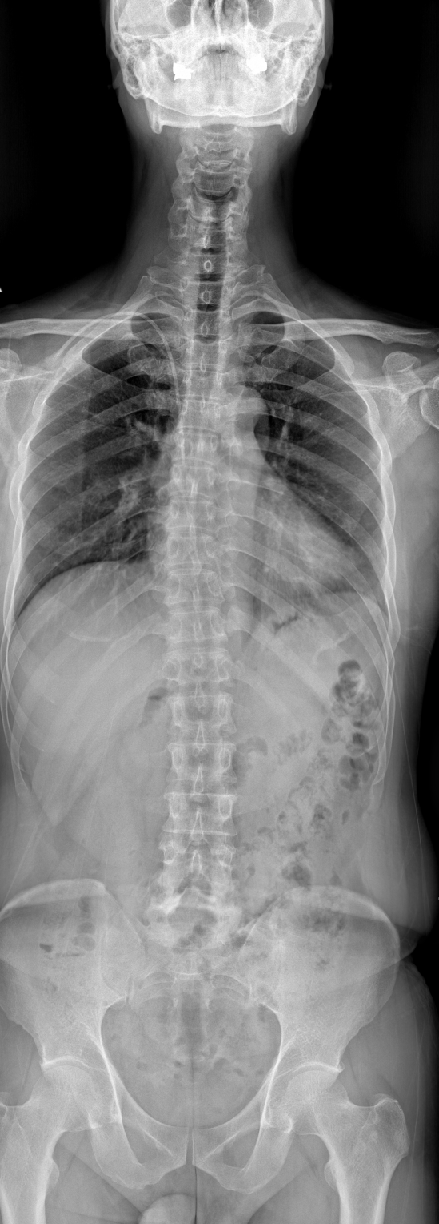
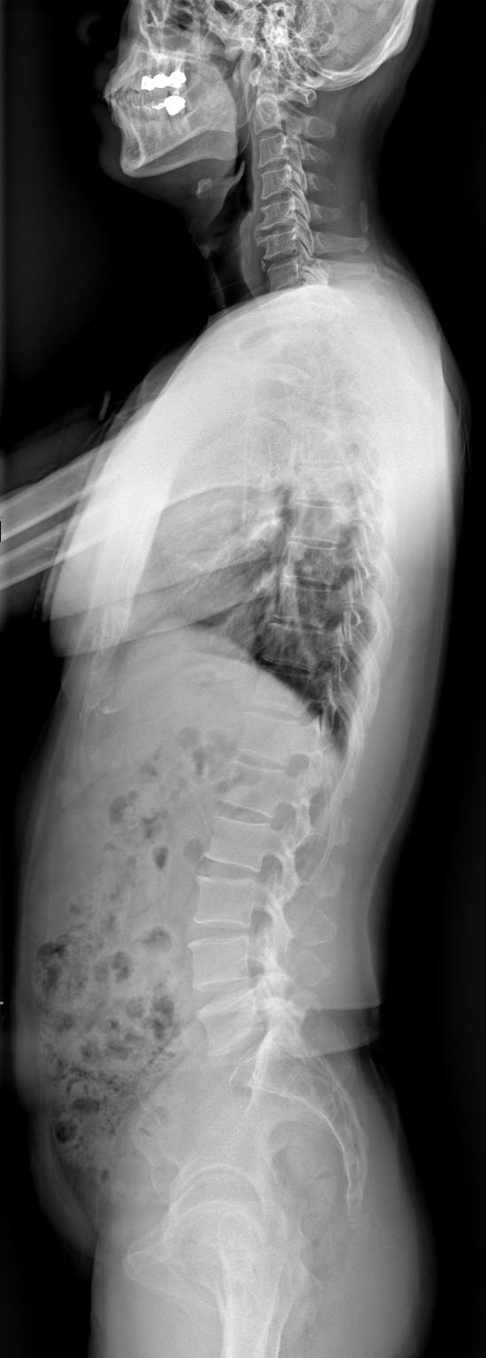
Case
51-year-old male
Low back pain
Left buttock and whole-leg radiculopathy
Persistent for 5 months
Refractory to conservative treatment
Motor Examination
L2 (HIp flexion) : Gr V / G iV
L3 (Knee extension) : Gr V / Gr V
L4 (Ankle dorsiflexion) : Gr V / Gr V
L5 (Great toe dorsiflexion) : Gr V / Gr V
S1 (Ankle plantar flexion) : Gr V / Gr V

Slide 3
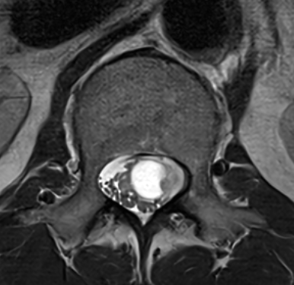
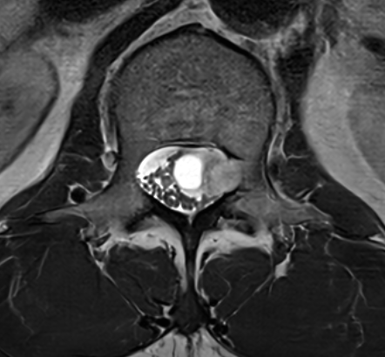
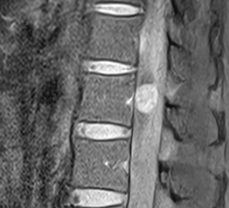
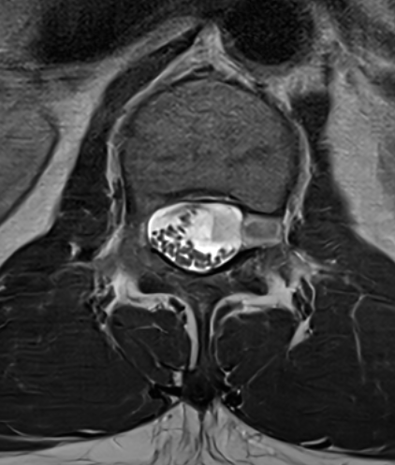
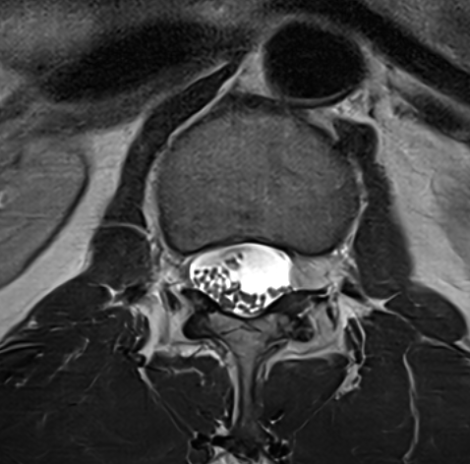
Conus medullaris
L1-2 Level
L1-2 Level
Fusiform mass
Intradural extramedullary (IDEM)
Size: 2.1x1.5 cm
Differential Diagnosis
Neurogenic tumor (e.g. schwannoma)
Neurofibroma
Malignant peripheral nerve sheath tumor
L1-2 Level

Slide 4
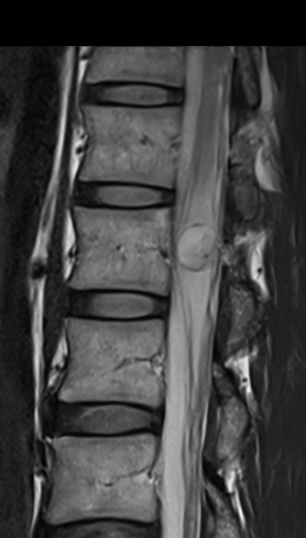
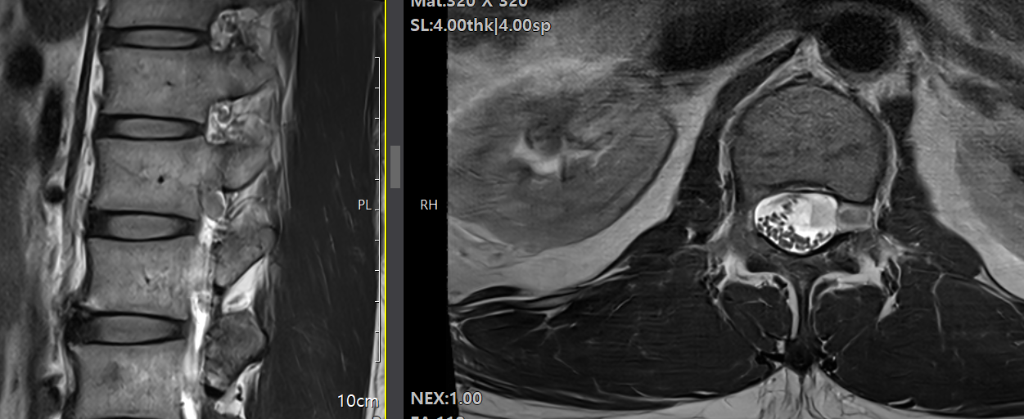
Lt L1 Nerve Root Origin
Dumbbell shaped Neurogenic Tumor
Oblique View

Slide 5
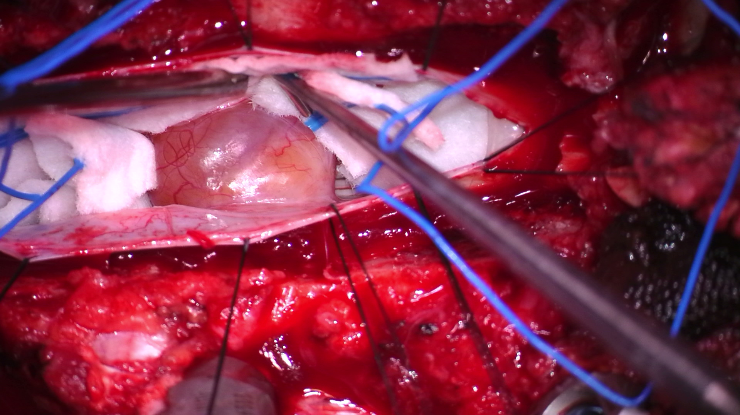
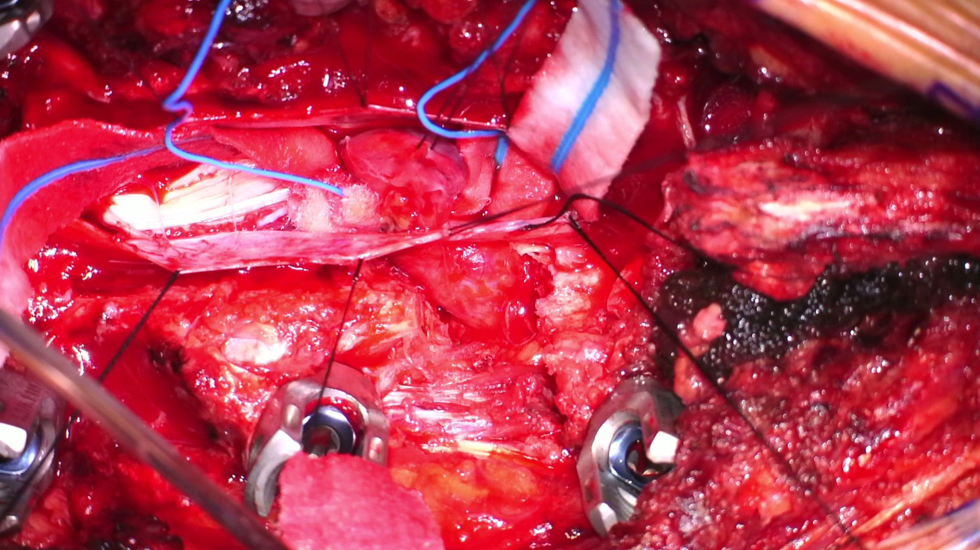
Schwannoma
Nerve Root
: Dumbbell shape part
(Total Facetectomy Exposure)

Slide 6
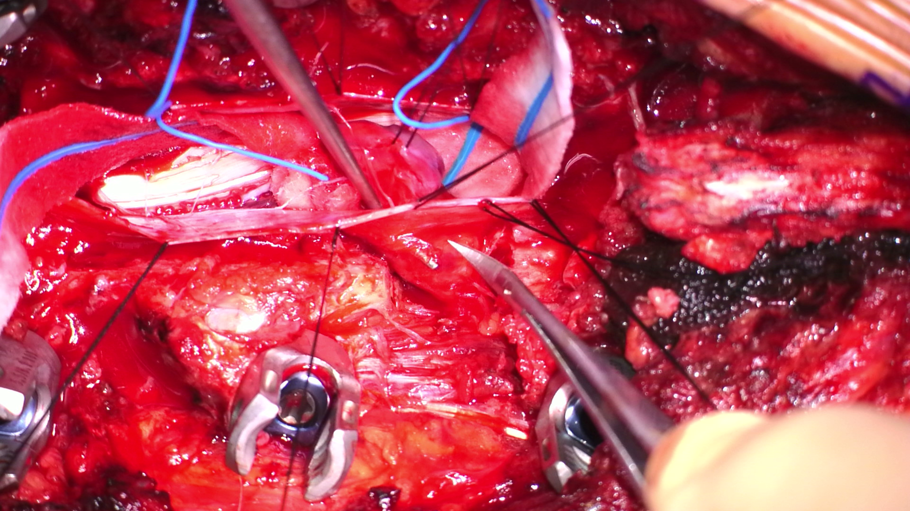
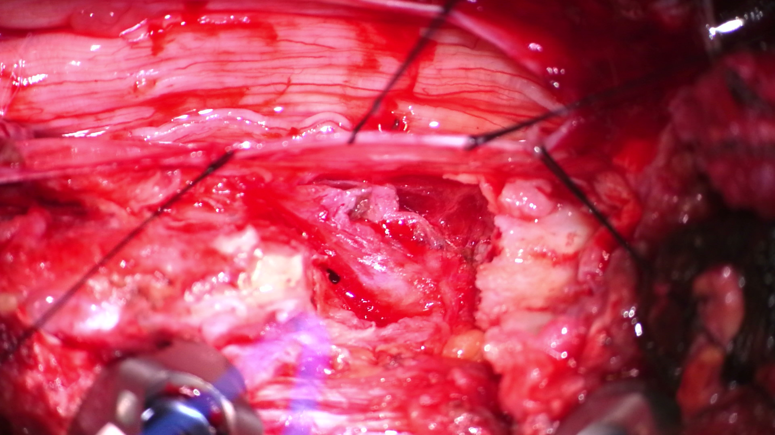
Nerve Root
: Dumbbell shape part
: Dissection
Nerve Root
: Dumbbell shape part
: Debulked

Slide 7
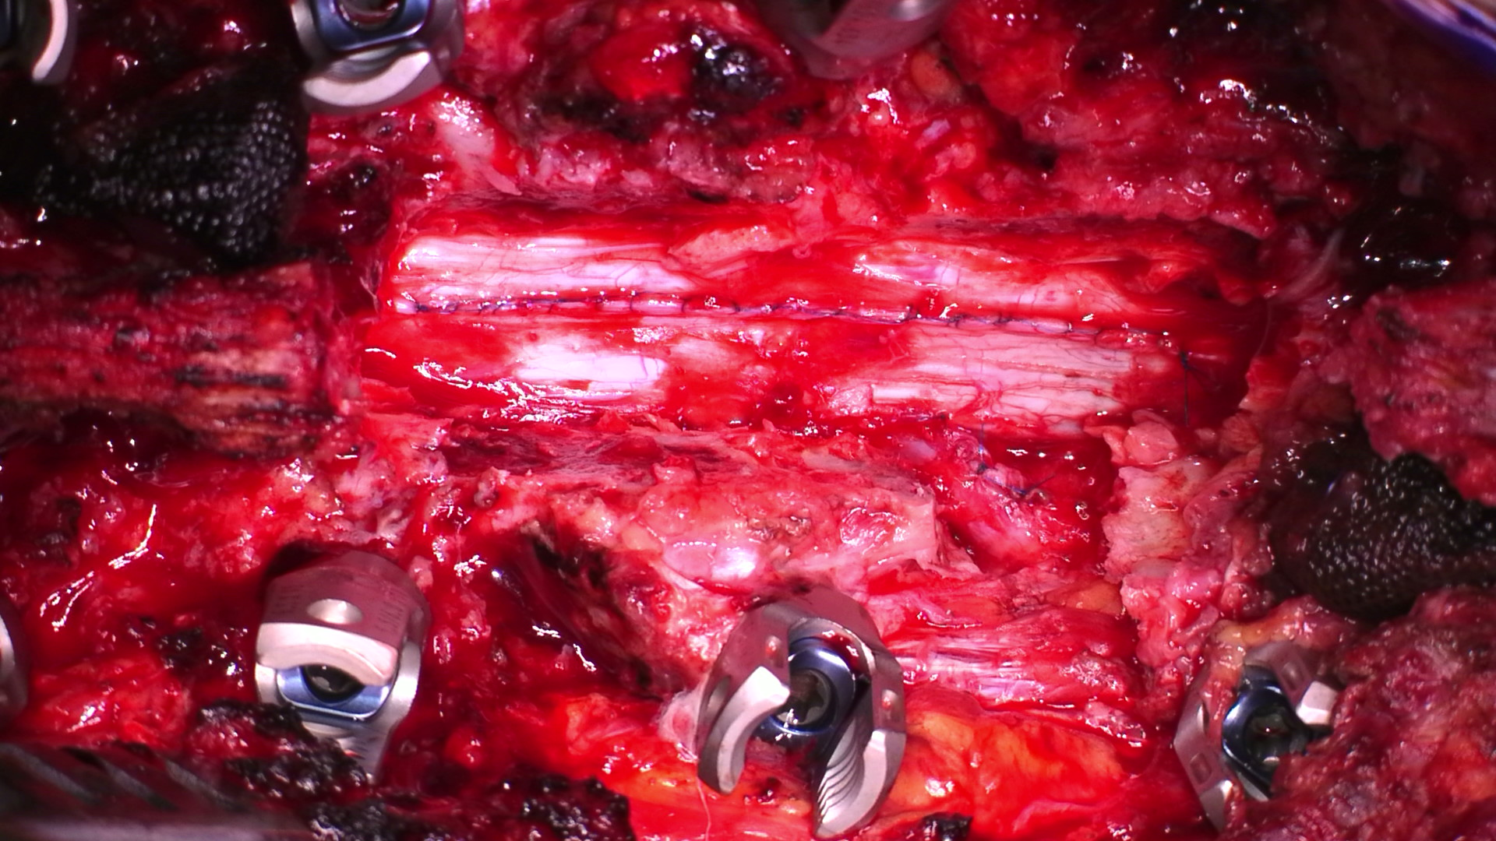
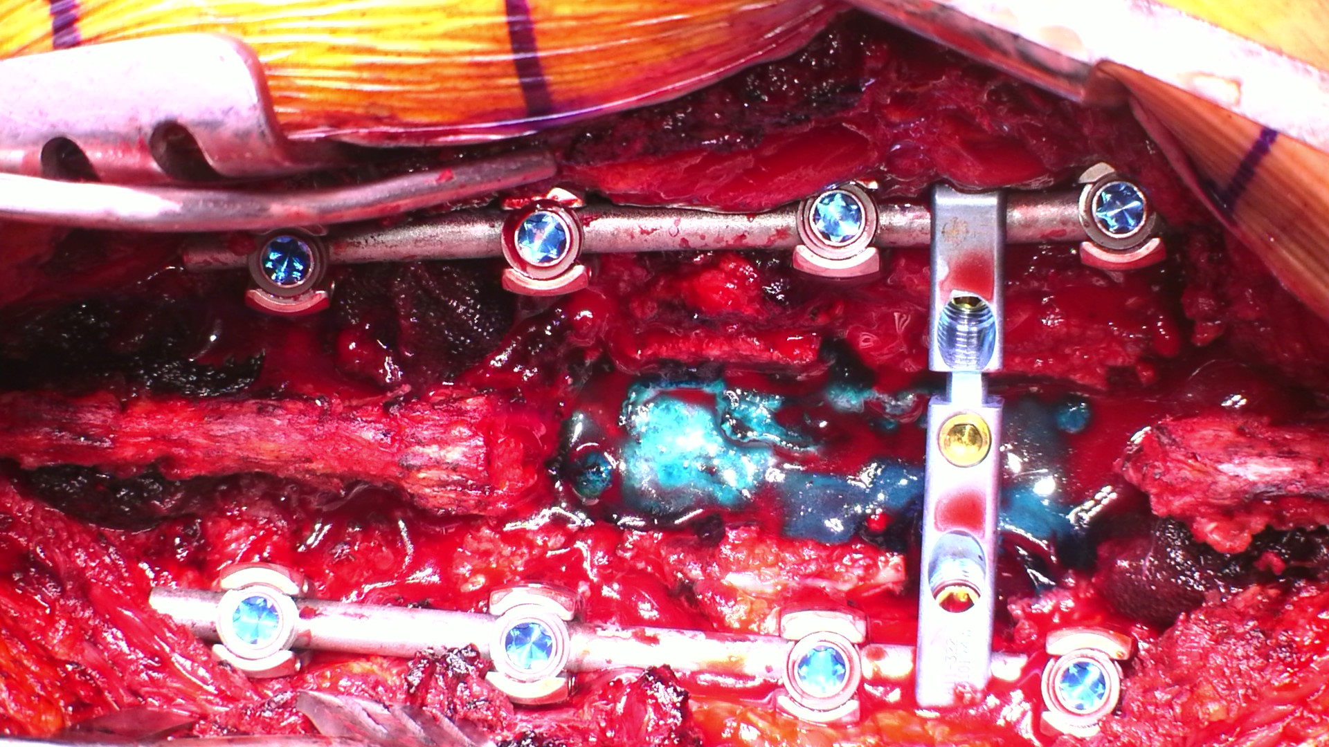
Nerve Root
: Dumbbell shape part
: Debulked
: Sheath Closure – Repaired
Nerve Root
: Dumbbell shape part
: Total Facetectomy –
: Post. Instremented Fusion

Slide 8
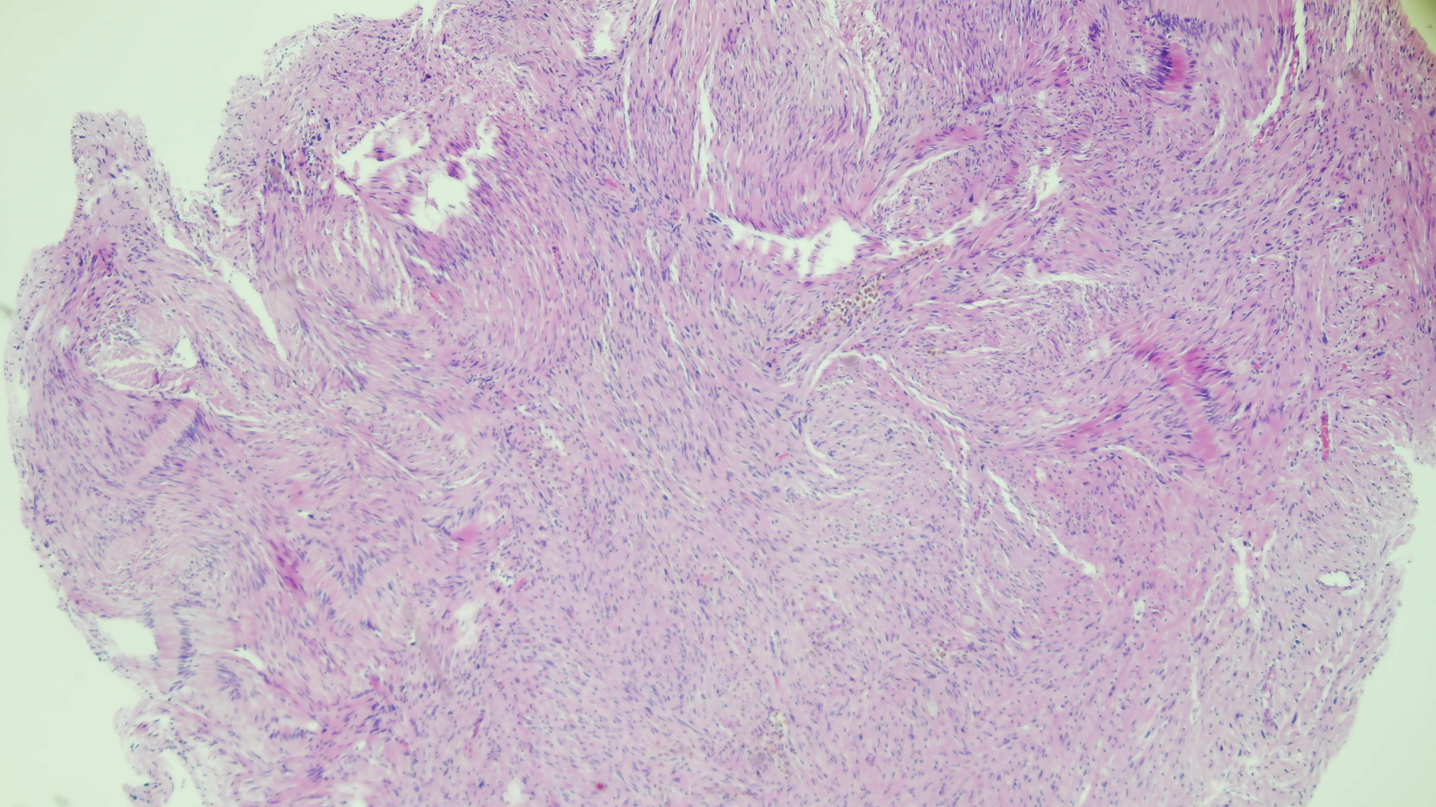
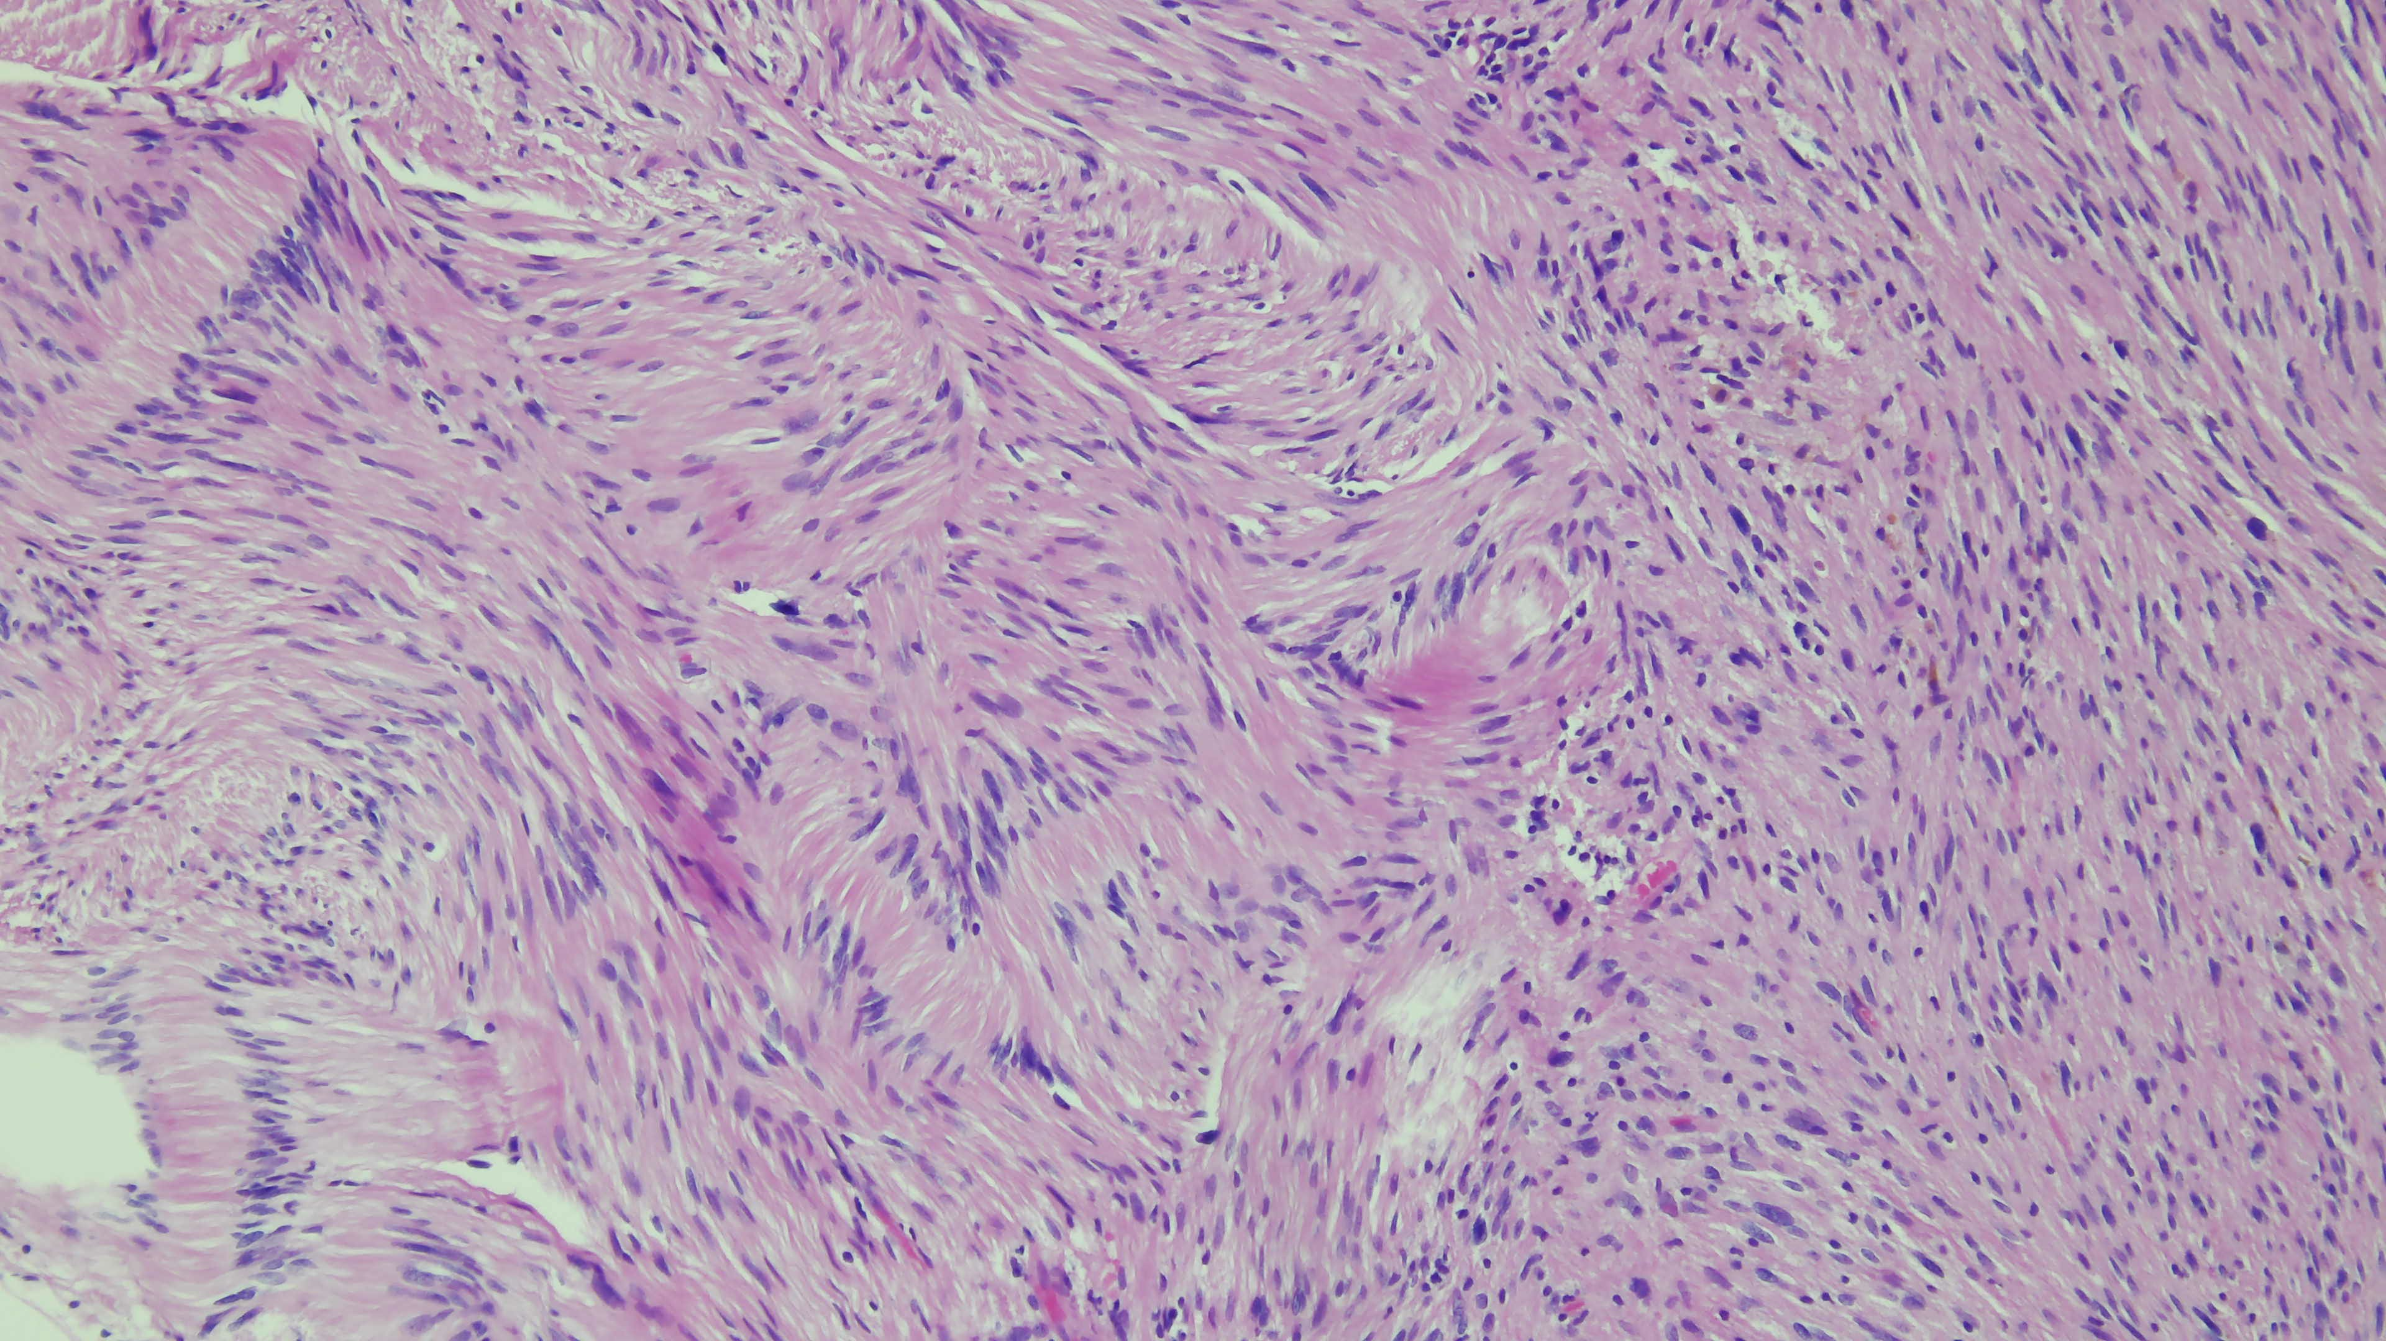
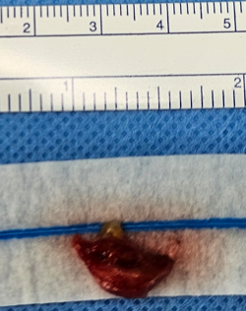

Slide 9
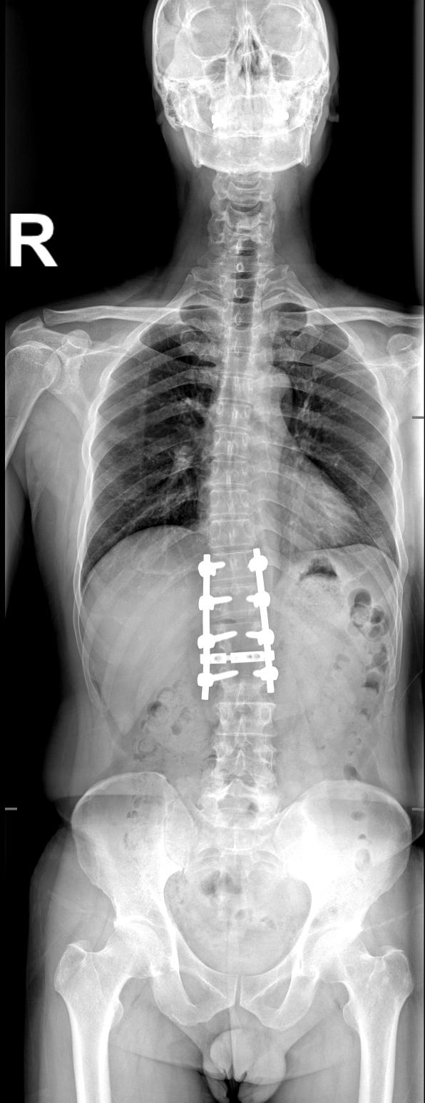
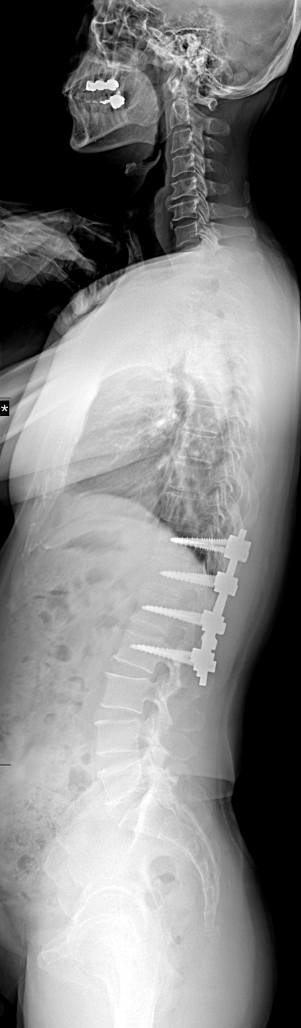
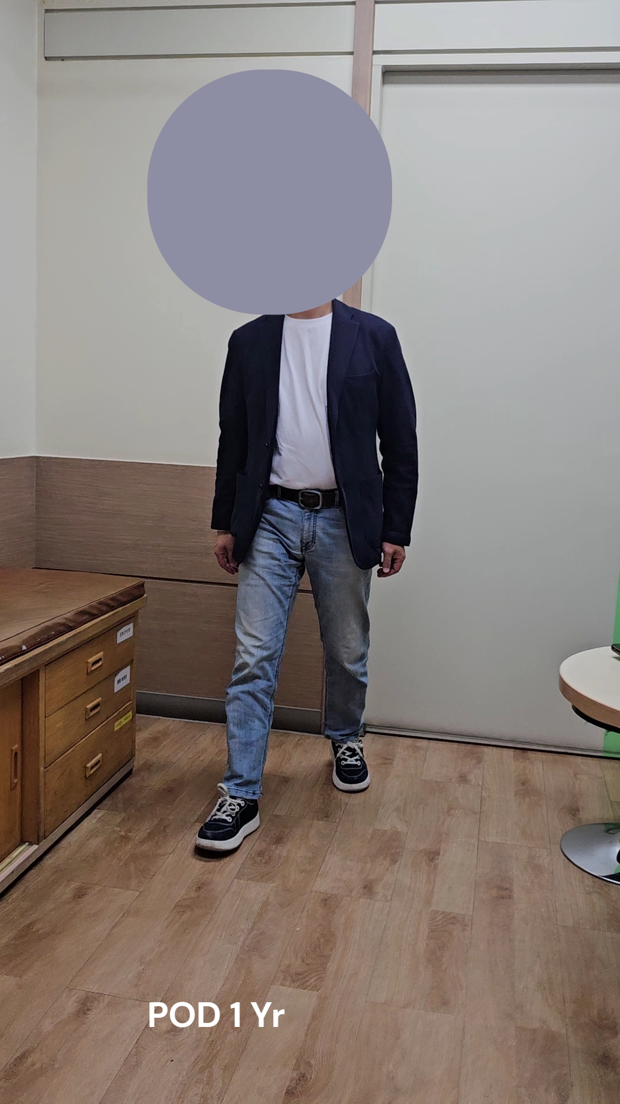
Schwannoma at L1-2 (left) , dumbbell-shaped
Laminectomy T12-L1
Unilaeral facetectomy: L1-2 (left)
PIF T12-L2
Pathology: Schwannoma (benign)

Slide 10
Thank you for your Attention

