Slide 1
Clinical Profile of Chronic Low Back Pain Patients after Unilateral Biportal Endoscopic (UBE) Spine Surgery: A Retrospective Cohort Study
Ma. Ella Muriel F. Valdevieso
Chong Hua Hospital, Cebu City, Philippines

Slide 2
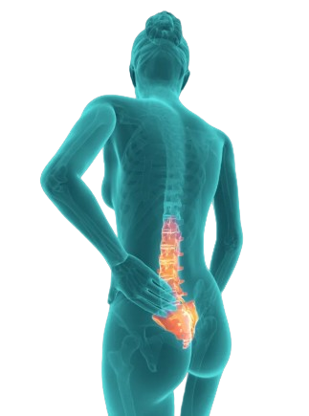
INTRODUCTION
Chronic low back pain (CLBP) is a leading cause of disability globally.
It significantly affects quality of life and productivity.
Surgical intervention is considered when conservative management fails.
Unilateral Biportal Endoscopic(UBE) spine surgery is a minimally invasive technique offering improved visualization and reduced tissue trauma.

Slide 3
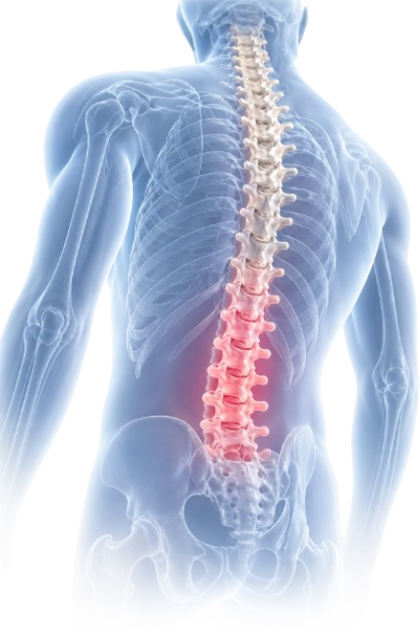
OBJECTIVES
SPECIFIC OBJECTIVES
GENERAL OBJECTIVE
1. Demographic profile
2. Etiology of Chronic low back pain
To determine the functional
outcomes and complication
rates of chronic low back pain
patients who underwent UBE
spine surgery.
3. Functional Outcome of Chronic low Back Patients after Unilateral Biport al Endoscopic (UBE) Spine Surgery using Oswestry
Disability Index (ODI) and Visual Analog Scale (VAS)
4. Level of Significant difference of Functional Outcome of Chronic low Back Pain Patients underwent UBE Spine Surgery
Pre-operative and post operatively
5. Complication rate of Chronic low Back Pain Patients after
UBE Spine Surgery

Slide 4





METHODOLOGY
Study Design
Study Population
Setting
Sample size
Data Collection
A Retrospective
cohort study.
Patients with
chronic low back
pain secondary to
lumbar stenosis,
lumbar disc
herniation, or
degenerative disc
disease.
Private Hospital in
the Philippines
56 patients
Pain and disability
assessed using
Numerical Rating
Scale (NRS) and
Oswestry Disability
Index (ODI),
preoperatively and
at follow-up.
Postoperative
complications were
recorded and
analyzed.

Slide 5
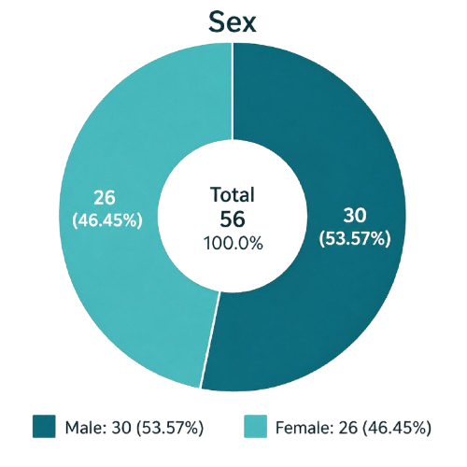
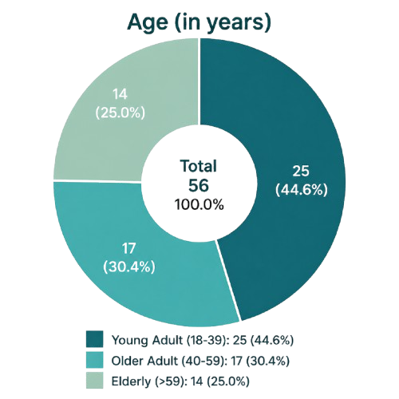
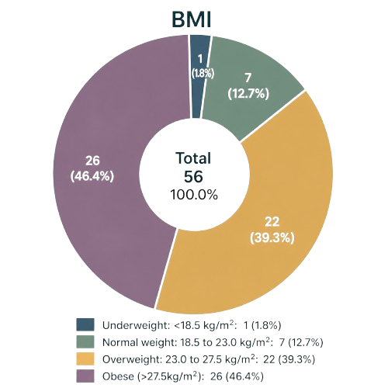
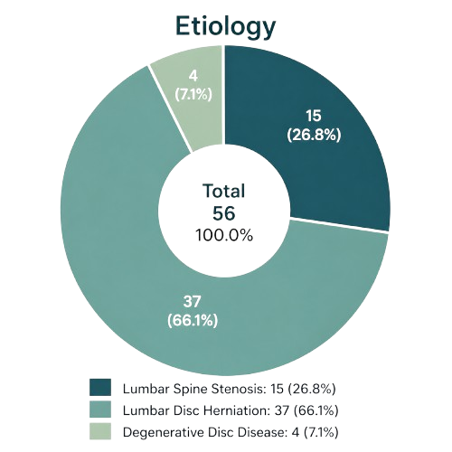
RESULTS - Demographics

Slide 6
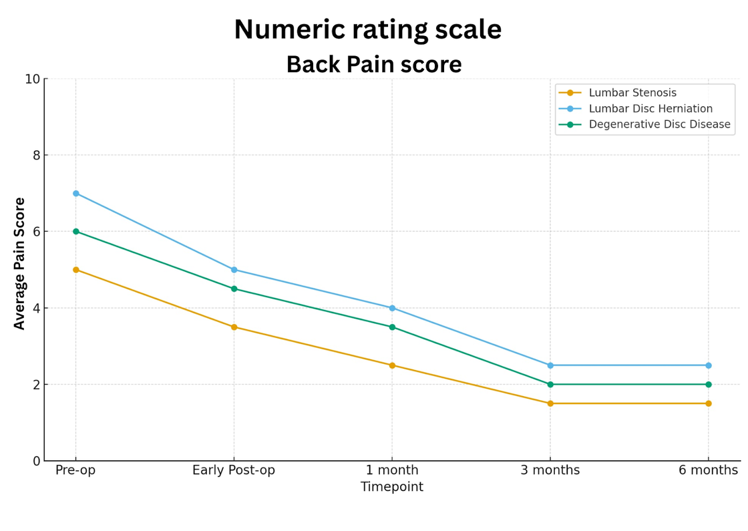
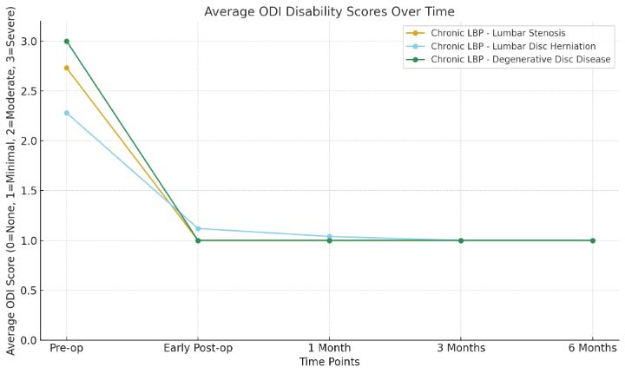
RESULTS - Clinical Outcomes
All groups demonstrated significant improvements in pain and functional status after UBE. Patients with lumbar disc herniation achieved the greatest immediate reduction in Numerical rating scale score and ODI scores, while those with degenerative disc disease showed the most sustained long-term improvement. Patients with lumbar stenosis had steady but gradual functional gains. The overall complication rate was 8.9% (5 of 56 cases), consisting of one reoperation, one case of hamstring tightness, one case of dorsiflexion weakness, one nerve injury, and one pneumonia-related mortality. Most complications were minor and manageable.

Slide 7
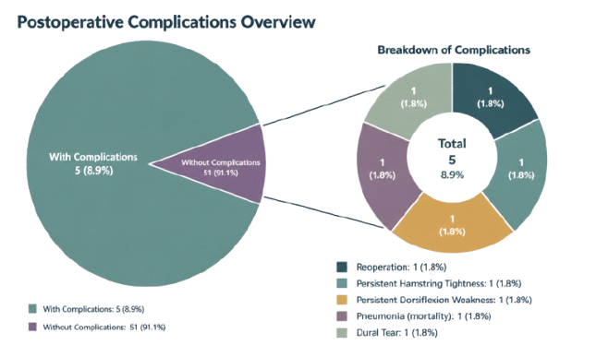
Complications
Without Complications: 51 (91.1%)
With Complications: 5 (8.9%)

Slide 8
DISCUSSION
UBE spine surgery significantly improved pain and functional outcomes in patients with lumbar stenosis, disc herniation, and degenerative disc
disease.
Patients showed sustained improvement in NRS and ODI scores up to
6 months postoperatively, with a low and manageable complication rate
(8.9%).
Findings support UBE as a safe and effective minimally invasive alternative to conventional spine surgery, although larger long-term studies are recommended.

Slide 9
CONCLUSION
UBE spine surgery significantly reduced pain and improved functional
outcomes in patients with chronic low back pain.
Disc herniation and degenerative disc disease patients showed the
greatest improvement, with a low and manageable complication rate (8.9%).
UBE is a safe and effective minimally invasive alternative to
conventional spine surgery.

Slide 10
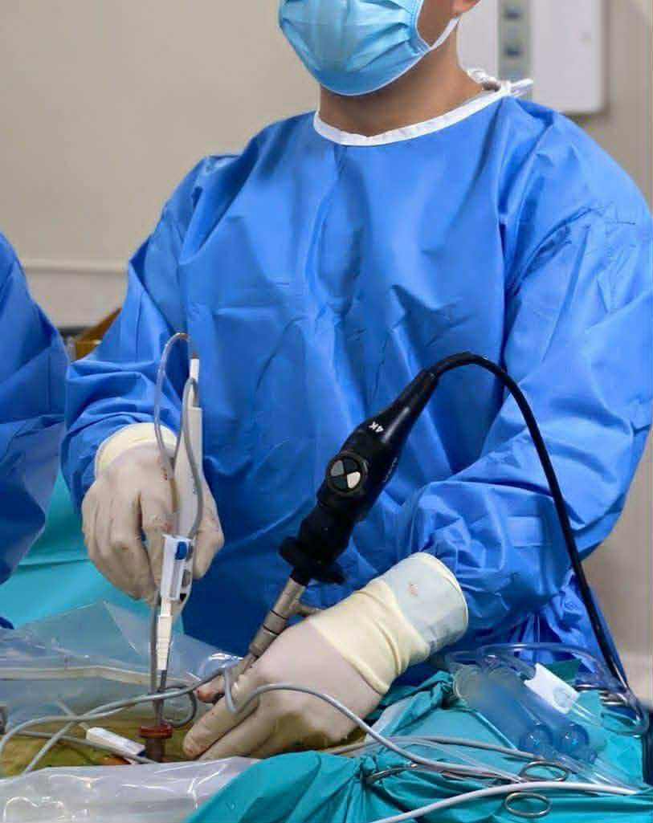
RECOMMENDATION
Conduct studies with larger sample sizes and longer follow-up periods to evaluate long-term outcomes of UBE spine surgery.
Compare UBE with conventional open and other minimally invasive spine procedures to further assess effectiveness and safety.
Strengthen postoperative monitoring and rehabilitation programs to optimize patient recovery and minimize complications.

Slide 11
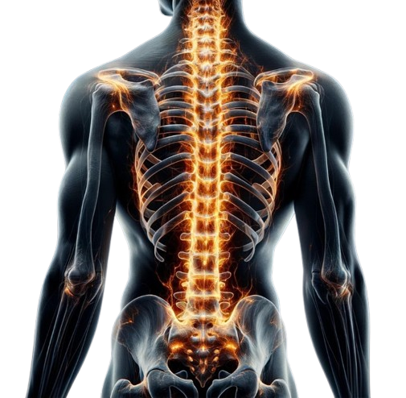
Thank you!

Slide 12
INTRODUCTION

Slide 13
OBJECTIVES
Content Here

Slide 14
METHODOLOGY
Content Here

Slide 15
METHODOLOGY

Slide 16
Slide Title Here
Content Here

Slide 17
Slide Title Here
Content Here

