Slide 1

Clinical Outcomes and Cost-Effectiveness of Demineralized Bone Matrix-Augmented Vertebroplasty for Osteoporotic Vertebral Compression Fractures
Sung Weon Jung, MD; Seung Myung Wi, MD
Department of Orthopaedic Surgery, Samsung Changwon Hospital,
Sungkyunkwan University School of Medicine
This study has been published online in Global Spine Journal Feb 10, 2026
https://doi.org/10.1177/21925682261426276

Slide 2

Introduction
Current Status of OVCF: A major cause of pain and decreased mobility in the elderly population.
Percutaneous Vertebroplasty (PVP): Standard treatment using PMMA bone cement; however, limitations include lack of biological activity and risk of adjacent segment fractures.
Role of Demineralized Bone Matrix (DBM):
Possesses osteoinductive and osteoconductive properties.
Potential to combine biological healing capacity with the mechanical stability of PMMA.
Rationale: Lack of empirical evidence regarding the clinical efficacy and economic viability of DBM-augmented PVP.

Slide 3
Study Objective & Hypothesis
Objective: To compare the clinical and radiologic outcomes, as well as the cost-effectiveness, of DBM-augmented vertebroplasty (VPDBM) versus conventional bone cement vertebroplasty (VPBC).
Hypothesis: Despite the initial higher cost, DBM augmentation will demonstrate superior cost-effectiveness by reducing treatment failure rates.

Slide 4
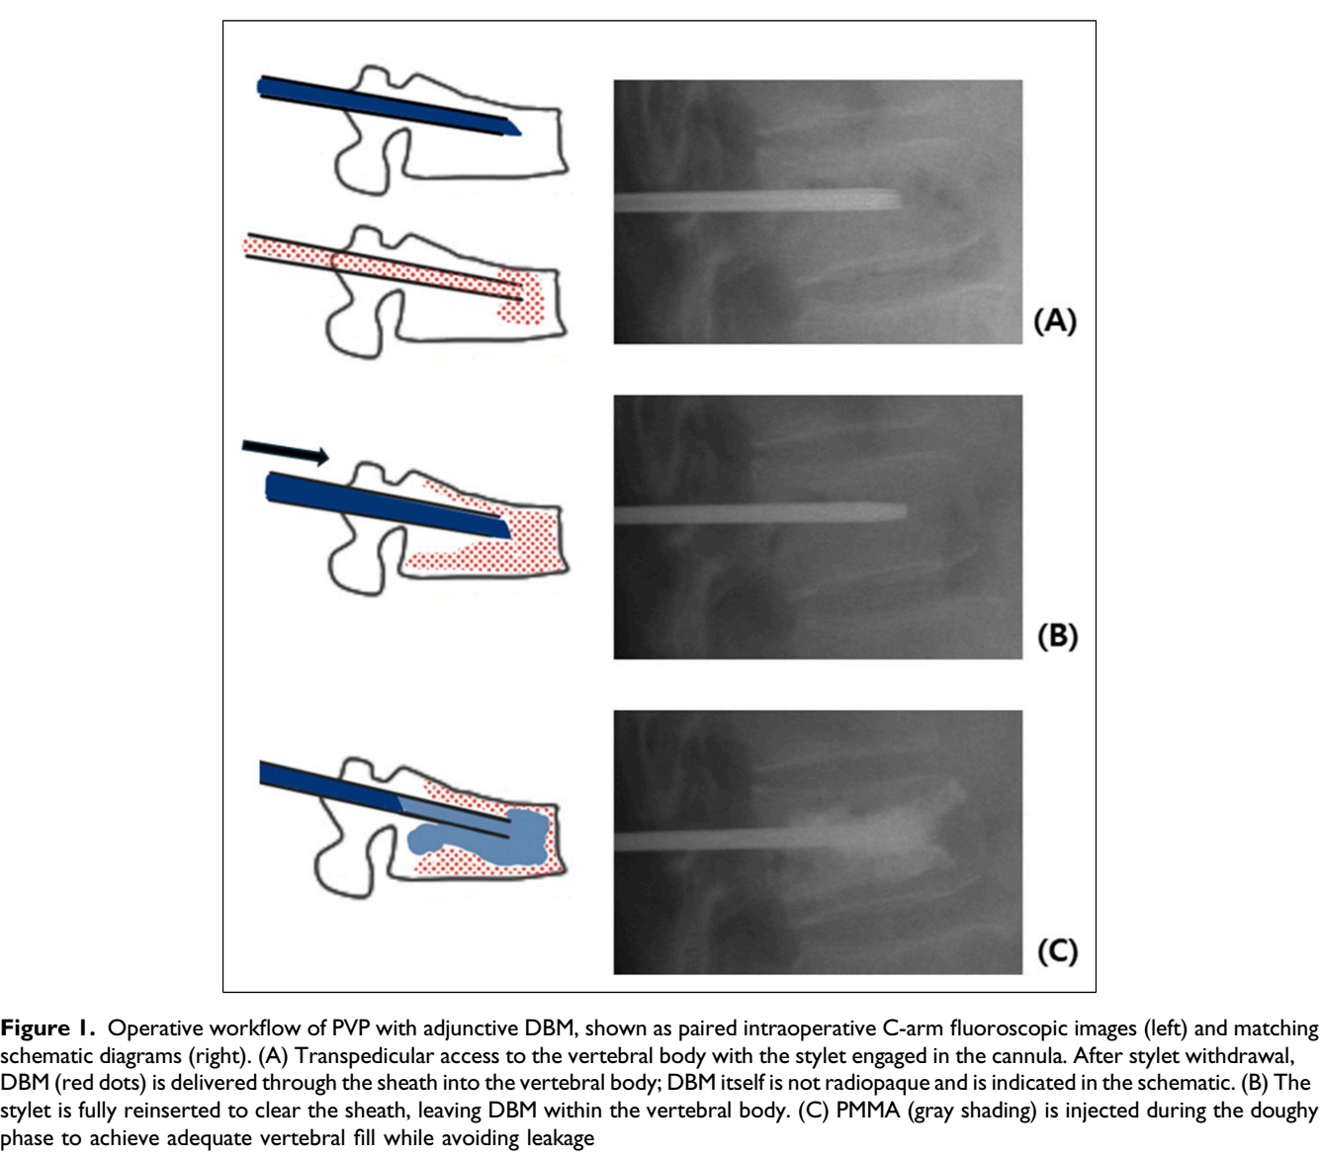
Materials and Methods
Study Design:
Retrospective cohort study (Jan 2020 – Mar 2025)
Participants: ≥ 60 years with acute OVCF (N=187)
VPDBM Group: n=103 (DBM + PMMA)
VPBC Group: n=84 (PMMA only)
Outcome Measures:
VAS (Pain), Koval grade (Ambulatory function)
Vertebral Kyphotic Angle (VKA), Local Kyphotic Angle (LKA), Correction Angle
Incremental Cost-Effectiveness Ratio (ICER) per 1% increase in Deterioration-Free Survival (DFS)

Slide 5
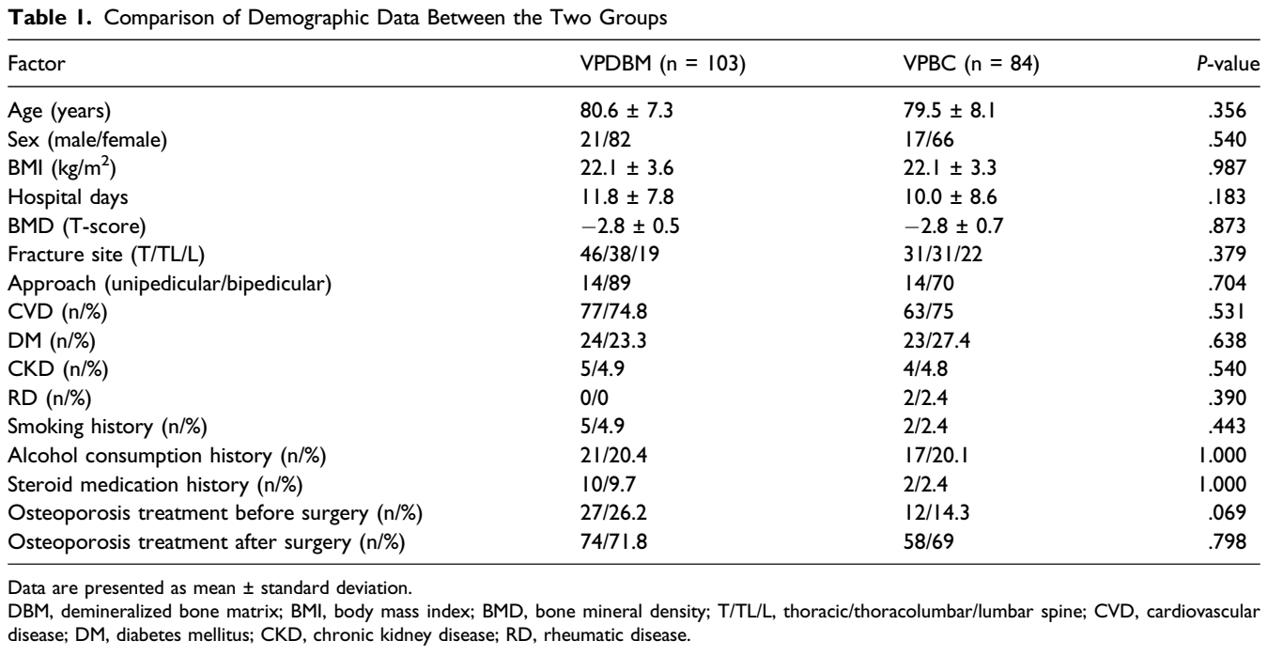
Demographic Data

Slide 6
Clinical & Radiologic Results
Clinical Outcomes: Both groups showed significant improvement in VAS and Koval grades at 12-month follow-up (no significant intergroup differences).
Radiologic Outcomes:
No significant differences in VKA or LKA between groups.
Correction Angle: VPBC showed initial superiority (p=0.041), but the difference vanished by the 12-month mark.
DBM augmentation does not compromise short-term analgesic efficacy.

Slide 7
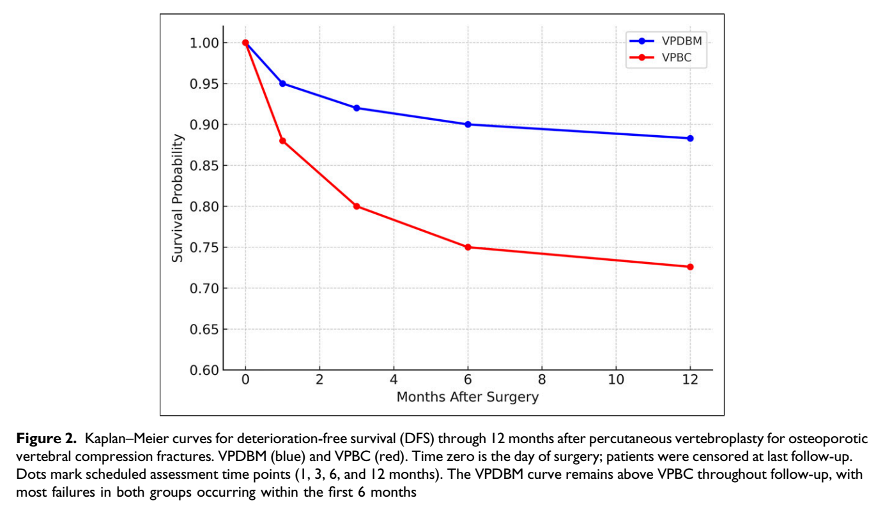
Treatment Failure & Survival Analysis
Composite Treatment Failure Rate:
VPDBM: 12.6% vs. VPBC: 27.4% (p=0.010)
Relative Risk: 0.46 (54% risk reduction); NNT: 6.8
Kaplan-Meier Analysis:
VPDBM group demonstrated significantly higher DFS (p=0.034).
Most failure events occurred within the first 6 months postoperatively.

Slide 8
Cost-Effectiveness Analysis
Cost Analysis: Higher initial cost in the VPDBM group due to DBM material expenses (₩883,200).
Effectiveness Metric: Deterioration-Free Survival (DFS)
ICER Results:
Additional cost per 1% increase in DFS: ₩43,978 ($32.0)
The ratio is well below standard Willingness-to-Pay (WTP) thresholds, confirming high cost-effectiveness.

Slide 9
Discussion
Both VPDBM and VPBC showed similar improvements in pain and function. However, VPDBM resulted in a lower treatment failure rate and improved DFS.
This suggests that while short-term clinical outcomes are mainly driven by mechanical stabilization, DBM may enhance long-term structural durability through its biological effects.
Most failures occurred within 6 months, indicating the need for early monitoring and optimized osteoporosis management.
Study Limitations:
As a retrospective cohort study, there may be inherent selection bias despite efforts to standardize treatment.
The study was conducted at a single institution with a relatively small cohort, which may limit the generalizability of the findings to broader populations.
A 12-month follow-up period may not be sufficient to capture very long-term complications, such as late-onset adjacent segment fractures or delayed DBM remodeling.
The cost-effectiveness analysis was primarily focused on material costs and direct clinical outcomes; indirect costs (e.g., caregiver burden, loss of productivity) were not included.

Slide 10
Conclusion
VPDBM is a clinically effective and cost-effective strategy for treating OVCF.
It reduces treatment failure and improves DFS compared with conventional VPBC.
Further prospective, multicenter randomized studies are required to validate these findings.

